Slide 1
Capstone Project
Film Rating Prediction
Presented By
Name:Thoufeeque Nazar
College Name: Maria College of Engineering and Technology
Department Name: Electrical and Electronic Engineering

Slide 2
OUTLINE
Problem Statement
Proposed System/Solution
System Development Approach
Algorithm & Deployment
Result
Conclusion
Future Scope
References

Slide 3
PROBLEM STATEMENT
Create a predictive model for website ratings using machine learning algorithms and historical website data, focusing on factors like user engagement and content quality. Evaluate model performance and provide actionable insights for website owners to enhance user satisfaction and optimize their online platforms.

Slide 4
PROPOSED SOLUTION
Preprocess website data using Python libraries like pandas to handle missing values, outliers, and encode categorical variables.
Perform exploratory data analysis (EDA) using matplotlib or seaborn to gain insights into website metrics, user behavior, and content characteristics.
Utilize scikit-learn to build predictive models such as linear regression, decision trees, or ensemble methods.
Conduct feature engineering to extract relevant features from the dataset, including user engagement metrics, content quality indicators, and demographic information.
Implement cross-validation techniques to assess model performance and ensure generalizability.
Fine-tune model hyperparameters using grid search or random search to optimize predictive accuracy.

Slide 5
SYSTEM APPROACH
Building the proposed solution would involve a combination of data processing, feature engineering, and machine learning. Here are the key system and library requirements
System Requirements:
1. Hardware:
A computer with sufficient processing power, preferably with multiple cores or a GPU for faster training of machine learning models.- Adequate RAM to handle the size of the dataset and computational requirements.
2. Software:
An operating system compatible with the required machine learning libraries (e.g., Windows, Linux,macOS)

Slide 6
SYSTEM APPROACH-CONT
Library Requirements:
1. Data Processing and Analysis:
Pandas: For data manipulation and analysis.
NumPy: For numerical operations on data.
2.Data Visualization:
Matplotlib and Seaborn: For creating visualizations to understand data patterns.
Plotly or Bokeh: Interactive visualization libraries for more complex visualizations.

Slide 7
ALGORITHM & DEPLOYMENT
Data Preprocessing:
Handle missing values, outliers, and encode categorical variables using techniques like imputation and one-hot encoding.
Feature Engineering:
Extract relevant features such as user engagement metrics (e.g., page views, bounce rate), content quality indicators (e.g., readability, keyword density), and demographic information (e.g., user location, age group).
Model Selection:
Choose appropriate machine learning algorithms such as linear regression, decision trees, random forests, or gradient boosting based on the nature of the problem and dataset characteristics.
Model Training:
Train the selected model(s) on the preprocessed data, using techniques like cross-validation to assess performance and prevent overfitting.
Model Evaluation:
Evaluate the trained model(s) using evaluation metrics such as mean squared error (MSE), root mean squared error (RMSE), or mean absolute error (MAE) to measure predictive accuracy

Slide 8
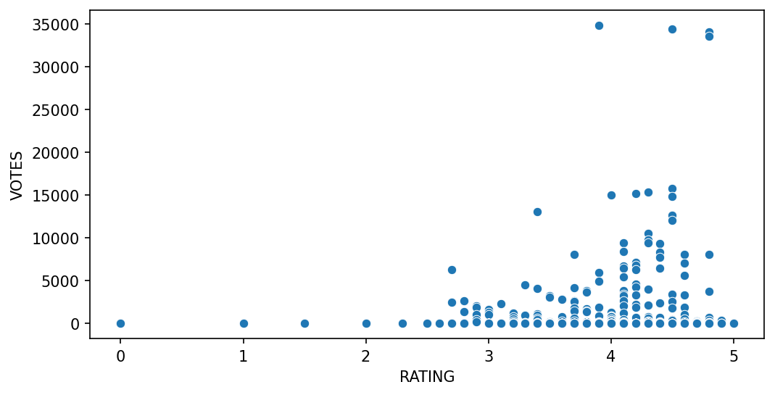
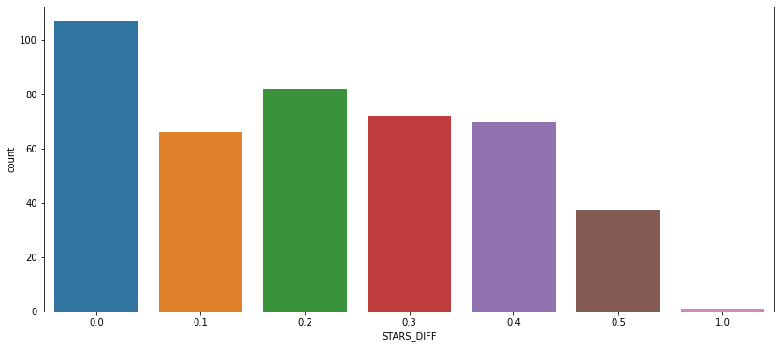
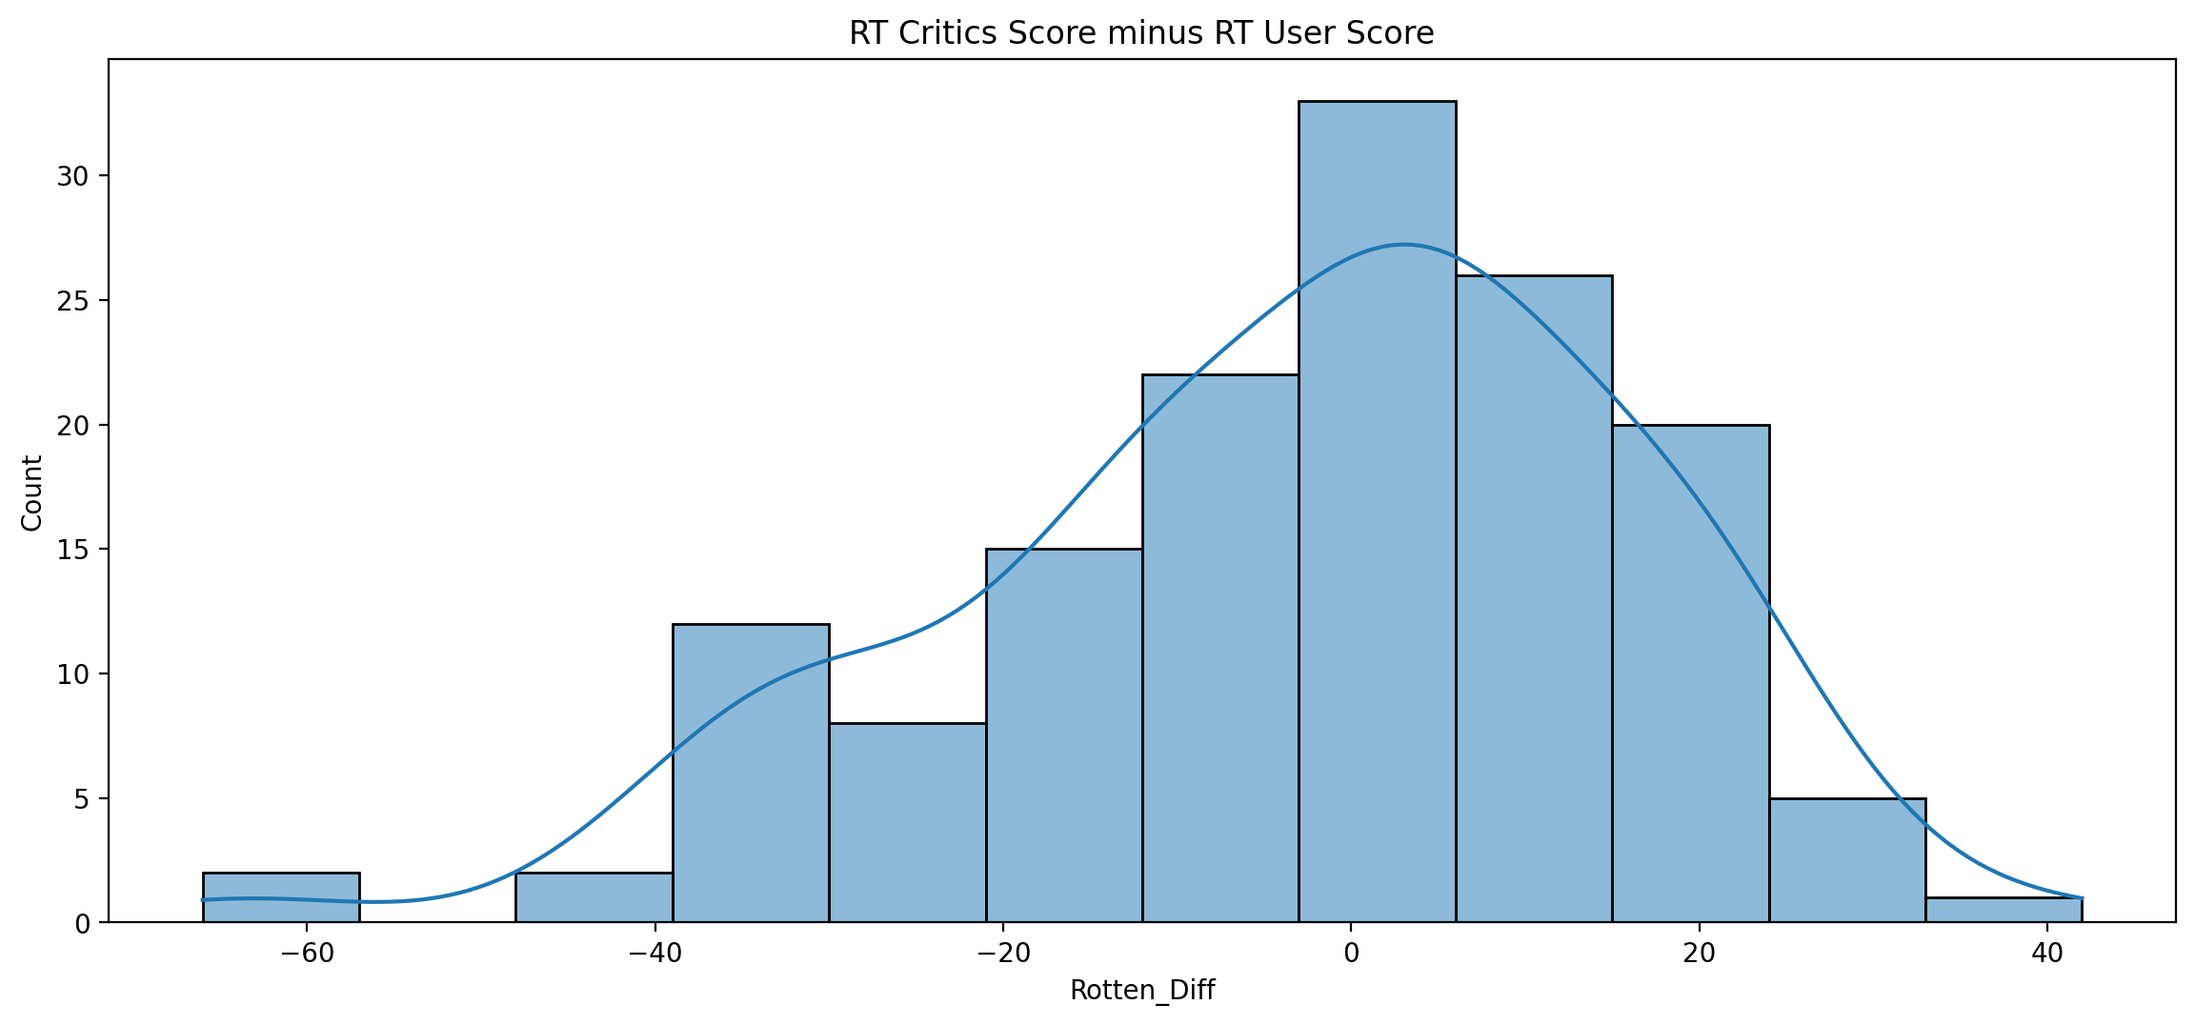
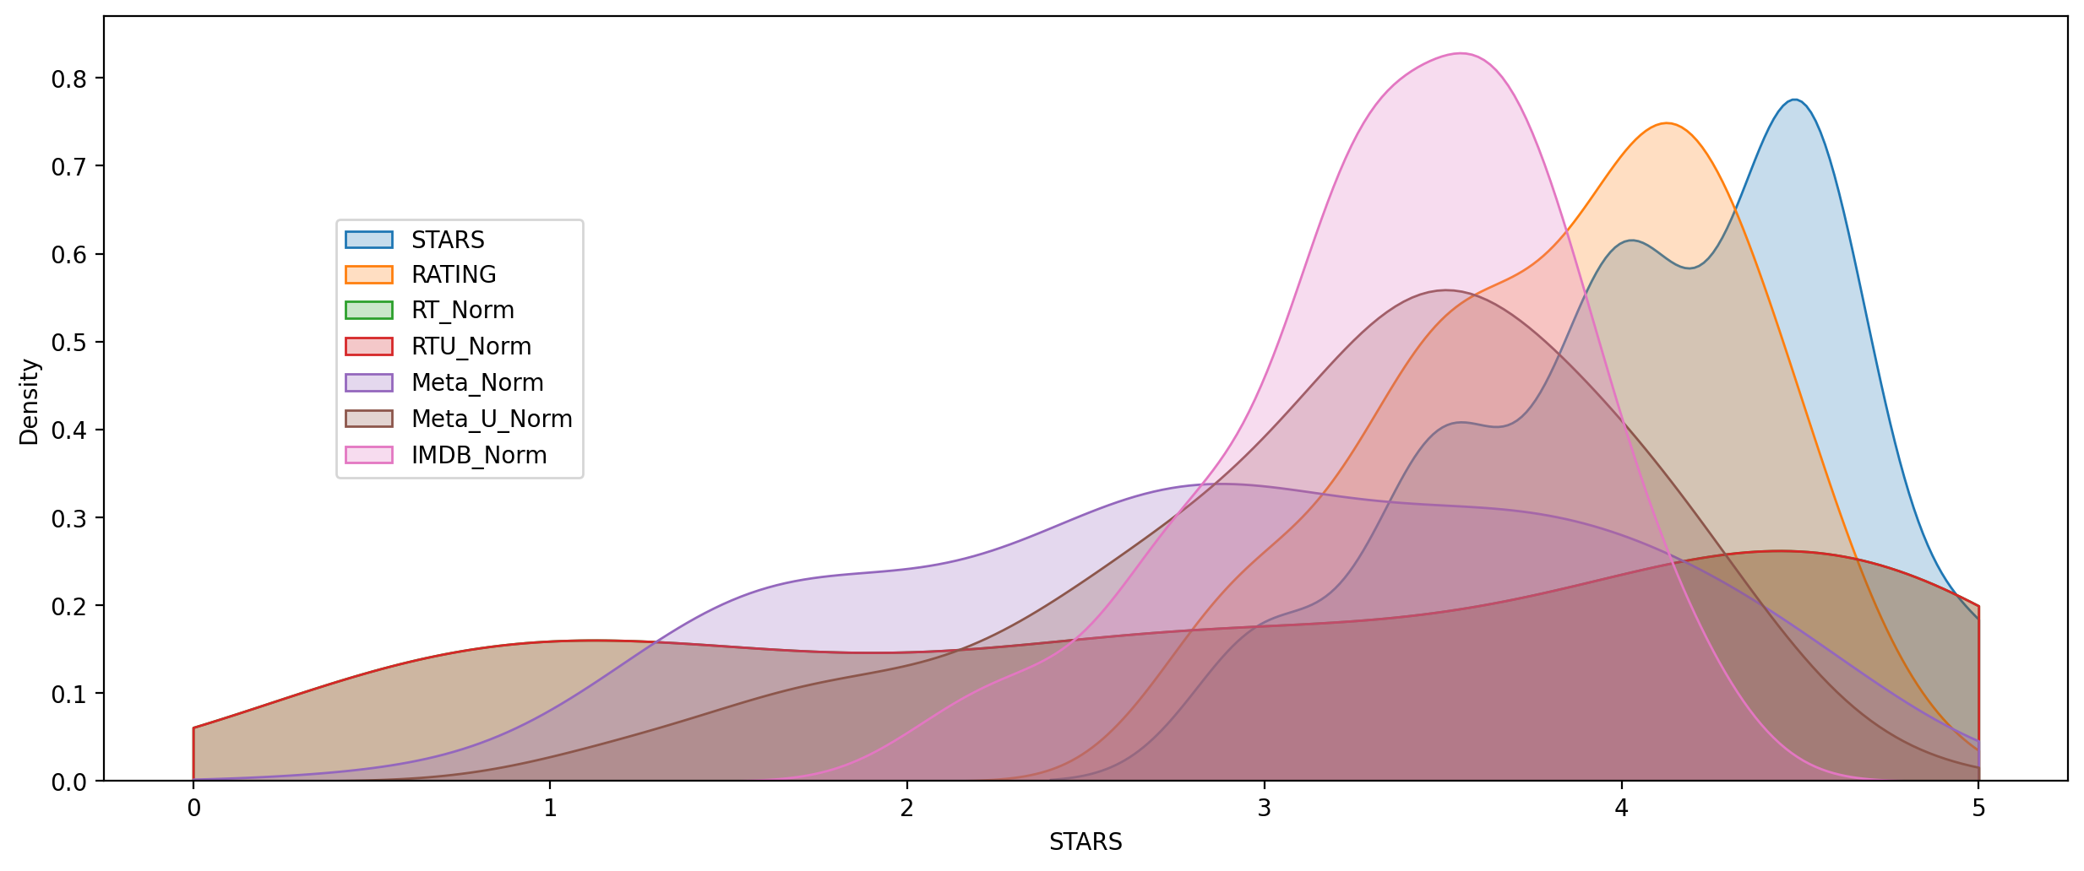
RESULT:

Slide 9
CONCLUSION
In conclusion, this project successfully utilized data science methodologies and Python programming to develop a predictive model for website ratings. The deployed web application provides website owners with a user-friendly interface to input data and receive accurate rating predictions, enabling informed decision-making for website optimization. This project underscores the significance of data-driven insights in improving website performance and highlights the potential for further advancements in web analytics through predictive modeling

Slide 10
FUTURE SCOPE
Extending the model to incorporate sentiment analysis of user reviews and social media discussions to capture nuanced audience preferences and sentiments, thereby enhancing the accuracy of rating predictions.
Implementing a recommendation system that suggests similar movies based on user preferences and predicted ratings, thereby improving user engagement and satisfaction on movie platforms.
Exploring the integration of contextual information such as release date, genre trends, and cultural events to capture temporal and contextual influences on movie ratings, enabling more nuanced predictions.
Collaborating with movie studios and streaming platforms to leverage the predictive model for targeted marketing campaigns and personalized content recommendations, ultimately optimizing box office performance and viewer satisfaction.

Slide 11
REFERENCES
https://www.kaggle.com/datasets
pandas - Python Data Analysis Library (pydata.org)
https://realpython.com/python-seaborn/
Pyplot tutorial — Matplotlib 3.8.4 documentation

Slide 12
THANK YOU

